Slide 1
005 Github介绍及基本 功能

Slide 2
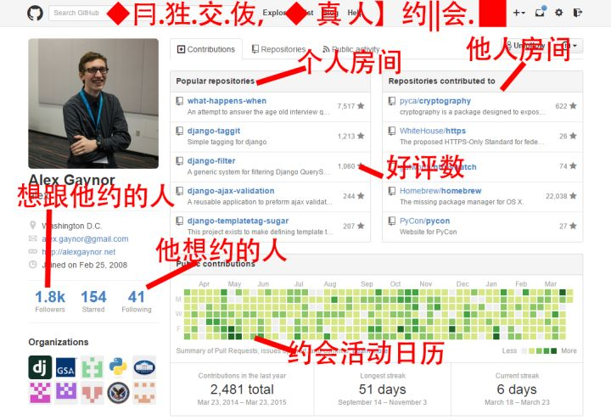
Github
https://www.zhihu.com/question/20070065/answer/79557687
https://lab.github.com/

Slide 3
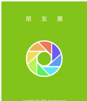

So what is github?
GitHub.com is a site for online storage of Git repositories.
Many open source projects use it, such as the Linux kernel.
You can get free space for open source projects or you can pay for private projects.

Slide 4
Differences between Git and Github?
Question: Do I have to use github to use Git?
Answer: No!
you can use Git completely locally for your own purposes, or
you or someone else could set up a server to share files, or
you could share a repo with users on the same file system, such as we did for homework 9 (as long everyone has the needed file permissions).

Slide 5
2.Github上的翻译项目

Slide 6
https://github.com/xiaolai
https://github.com/SwiftGGTeam/the-swift-programming-language-in-chinese

Slide 7
Translation Project
项目：Github文章翻译项目An Intro to Git and GitHub for Beginners (Tutorial)
目标：快速、准确、协作地翻译此篇文章，并通过Github交付。
要求：
1.基于Github制定翻译项目流程报告
2.客户能在Github上看到项目计划表，风格指南，术语表，翻译校对讨论过程等。
3.通过Github分支最后进行Pull Request到原客户项目库中.

